Slide 1
Probability for Reinforcement Learning

Slide 2
Probabilistic Machine Learning
Not all machine learning models are probabilistic
… but most of them have probabilistic interpretations
Predictions need to have associated confidence
Confidence = probability
Arguments for probabilistic approach
Complete framework for Machine Learning
Makes assumptions explicit
Recovers most non-probabilistic models as special cases

Slide 3
References Book
“Introduction to Probability Models”, Sheldon Ross
“Introduction to Probability and Statistics for Engineers and Scientists”, Sheldon Ross

Slide 4
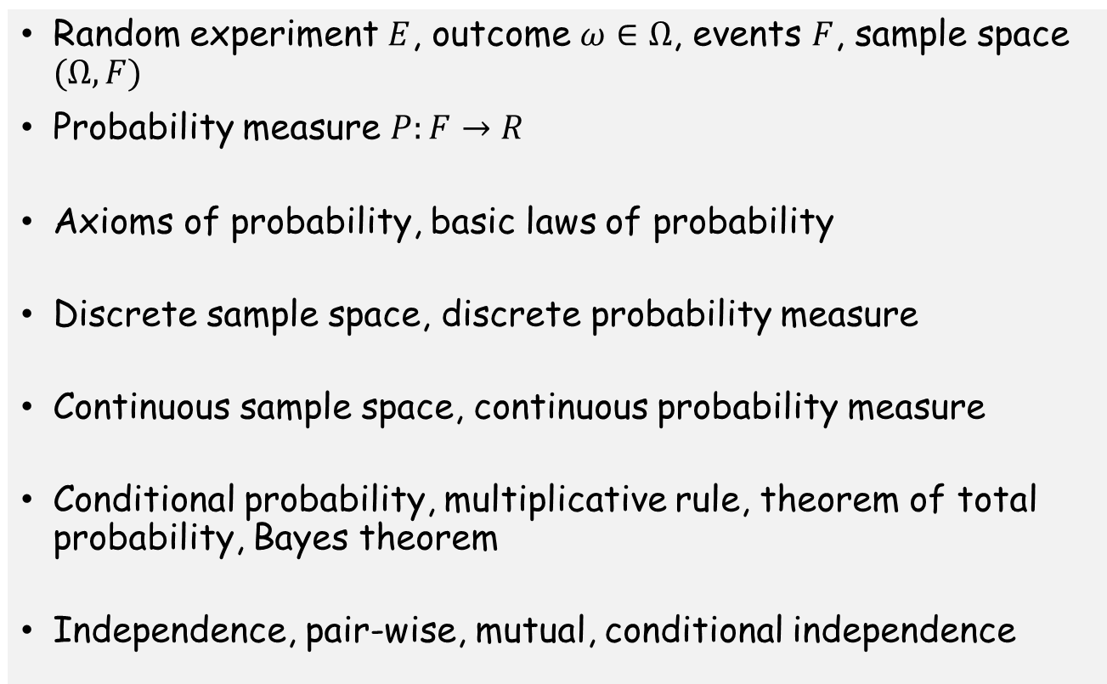
Basics
Random experiment $E$, outcome $ω∈Ω$, events $F$, sample space $(Ω,F)$
Probability measure $P:F→R$
Axioms of probability, basic laws of probability
Discrete sample space, discrete probability measure
Continuous sample space, continuous probability measure
Conditional probability, multiplicative rule, theorem of total probability, Bayes theorem
Independence, pair-wise, mutual, conditional independence

Slide 5
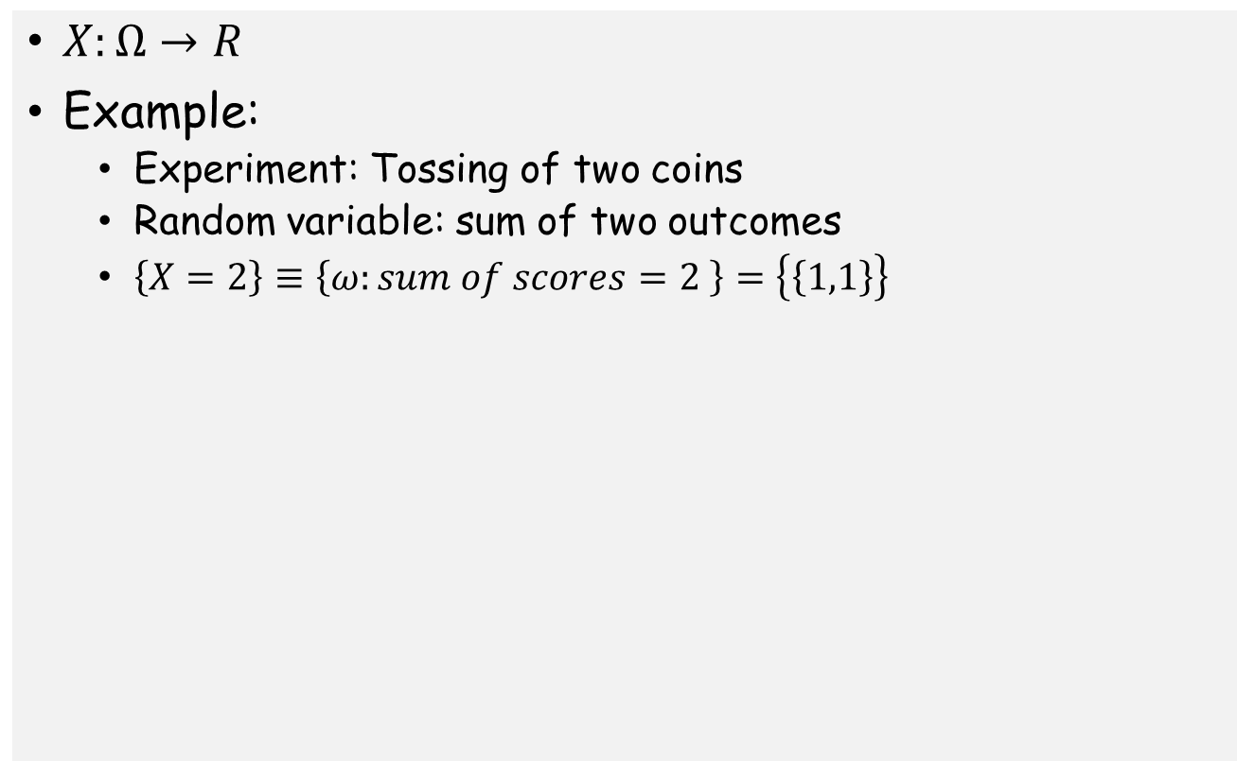
Random Variables
$X:Ω→R$
Example:
Experiment: Tossing of two coins
Random variable: sum of two outcomes
$\left\{X=2\right\}≡\left\{ω:sum of scores=2 \right\}=\left\{\left\{1,1\right\}\right\}$

Slide 6
Discrete Random Variables
Probability mass function (PMF)

Slide 7
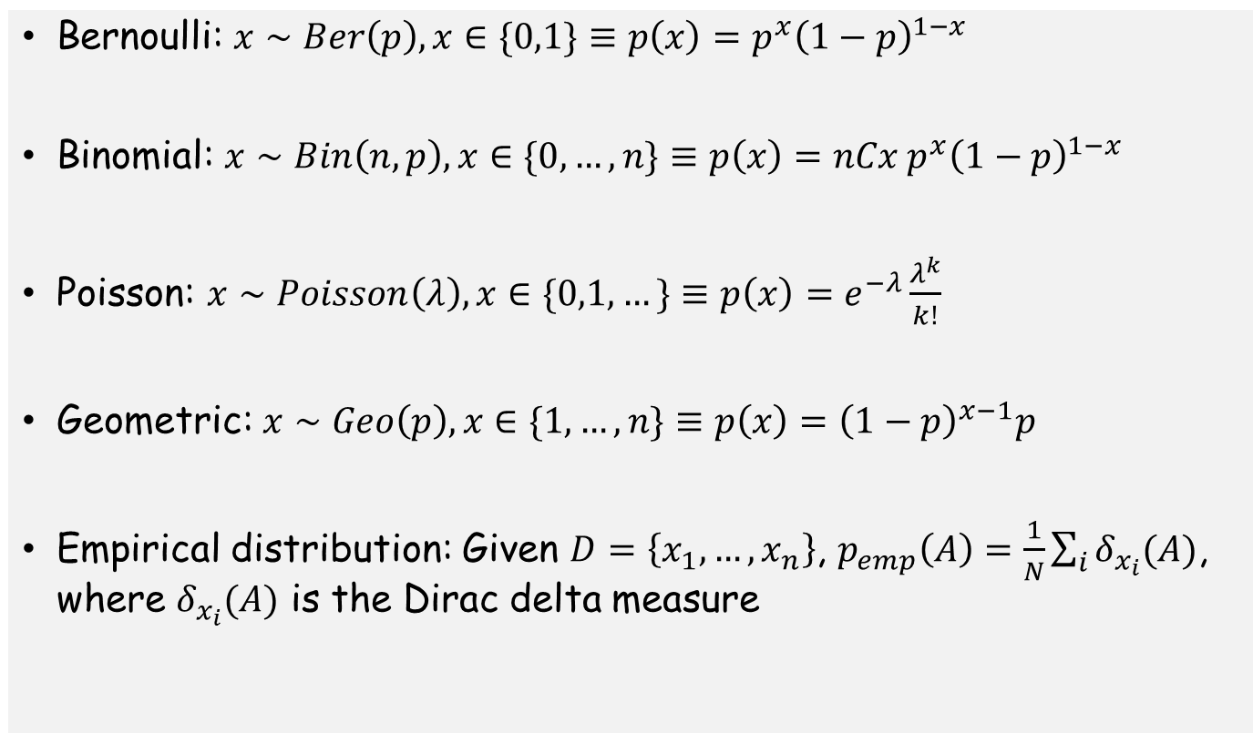
Example distributions: Discrete
Bernoulli: $x∼Ber\left(p\right), x∈\{0,1\}≡p\left(x\right)=p^{x}{\left(1−p\right)}^{1−x}$
Binomial: $x∼Bin\left(n,p\right), x∈\{0,…,n\}≡p\left(x\right)=nCx{ p}^{x}{\left(1−p\right)}^{1−x}$
Poisson: $x∼Poisson\left(λ\right), x∈\{0,1, …\}≡p\left(x\right)=e^{−λ}\frac{λ^{k}}{k!}$
Geometric: $x∼Geo\left(p\right), x∈\{1,…,n\}≡p\left(x\right)={\left(1−p\right)}^{x−1}p$
Empirical distribution: Given $D=\left\{x_{1},…,x_{n}\right\}$, $p_{emp}\left(A\right)=\frac{1}{N}\sum_{i}{δ_{x_{i}}(A)}$, where $δ_{x_{i}}(A)$ is the Dirac delta measure

Slide 8
Continuous Random Variables
Probability density function

Slide 9
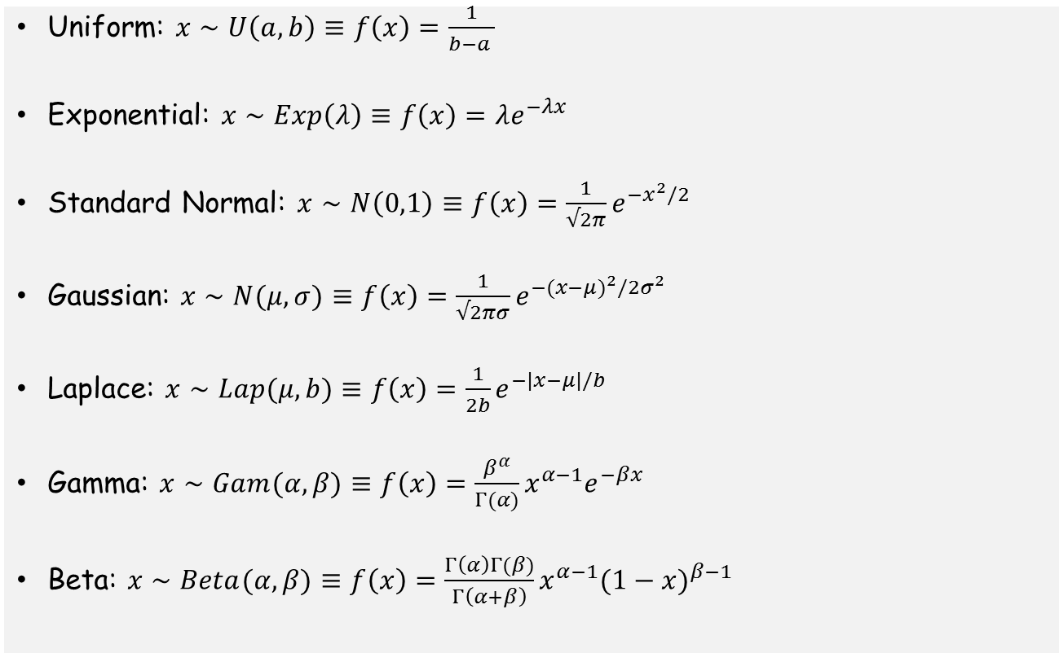
Example density functions
Uniform: $x∼U\left(a,b\right)≡f\left(x\right)=\frac{1}{b−a }$
Exponential: $x∼Exp\left(λ\right)≡f\left(x\right)=λe^{−λx}$
Standard Normal: $x∼N\left(0,1\right)≡f\left(x\right)={\frac{1}{√2π}e}^{−x^{2}/2}$
Gaussian: $x∼N(μ,σ)≡f\left(x\right)={\frac{1}{√2πσ}e}^{−({x−μ)}^{2}/2σ^{2}}$
Laplace: $x∼Lap(μ,b)≡f\left(x\right)={\frac{1}{2b}e}^{−|x−μ|/b}$
Gamma: $x∼Gam(α,β)≡f\left(x\right)={\frac{β^{α}}{Γ(α)}x^{α−1}e}^{−βx}$
Beta: $x∼Beta(α,β)≡f\left(x\right)={\frac{Γ\left(α\right)Γ(β)}{Γ\left(α+β\right)}x^{α−1}(1−x)}^{β−1}$

Slide 10
Random Variables
Cumulative distribution function

Slide 11
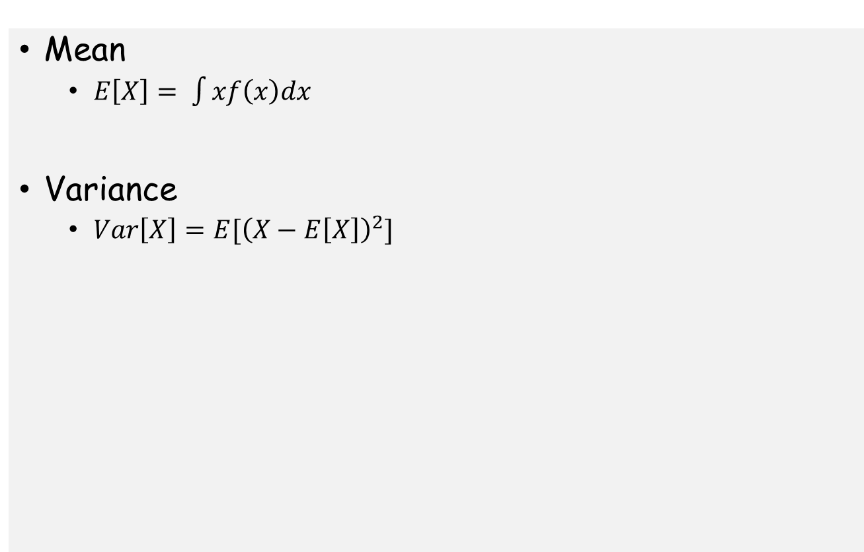
Moments
Mean
$E\left[X\right]= \int{xf\left(x\right)dx}$
Variance
$Var\left[X\right]=E[{\left(X−E\left[X\right]\right)}^{2}]$

Slide 12
Random Vectors and Joint Distributions
Discrete Random Vector
Joint pmf
Continuous Random Vector
Joint pdf

Slide 13
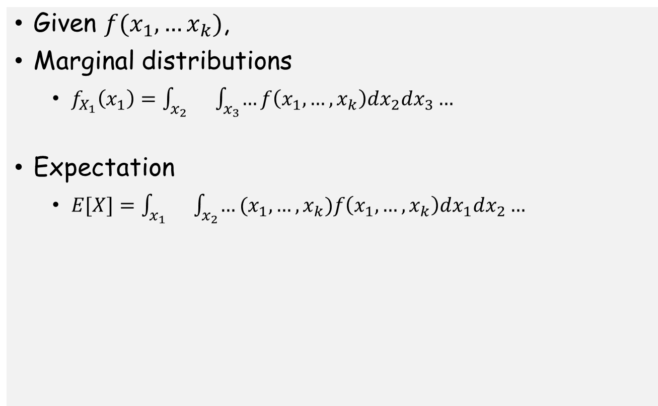
Random Vectors and Joint Distributions
Given $f(x_{1},…x_{k})$,
Marginal distributions
$f_{X_{1}}\left(x_{1}\right)=\int_{x_{2}}{}\int_{x_{3}}{…}f\left(x_{1},…,x_{k}\right)dx_{2}dx_{3}…$
Expectation
$E[X]=\int_{x_{1}}{}\int_{x_{2}}{…}(x_{1},…,x_{k})f\left(x_{1},…,x_{k}\right)dx_{1}dx_{2}…$

Slide 14
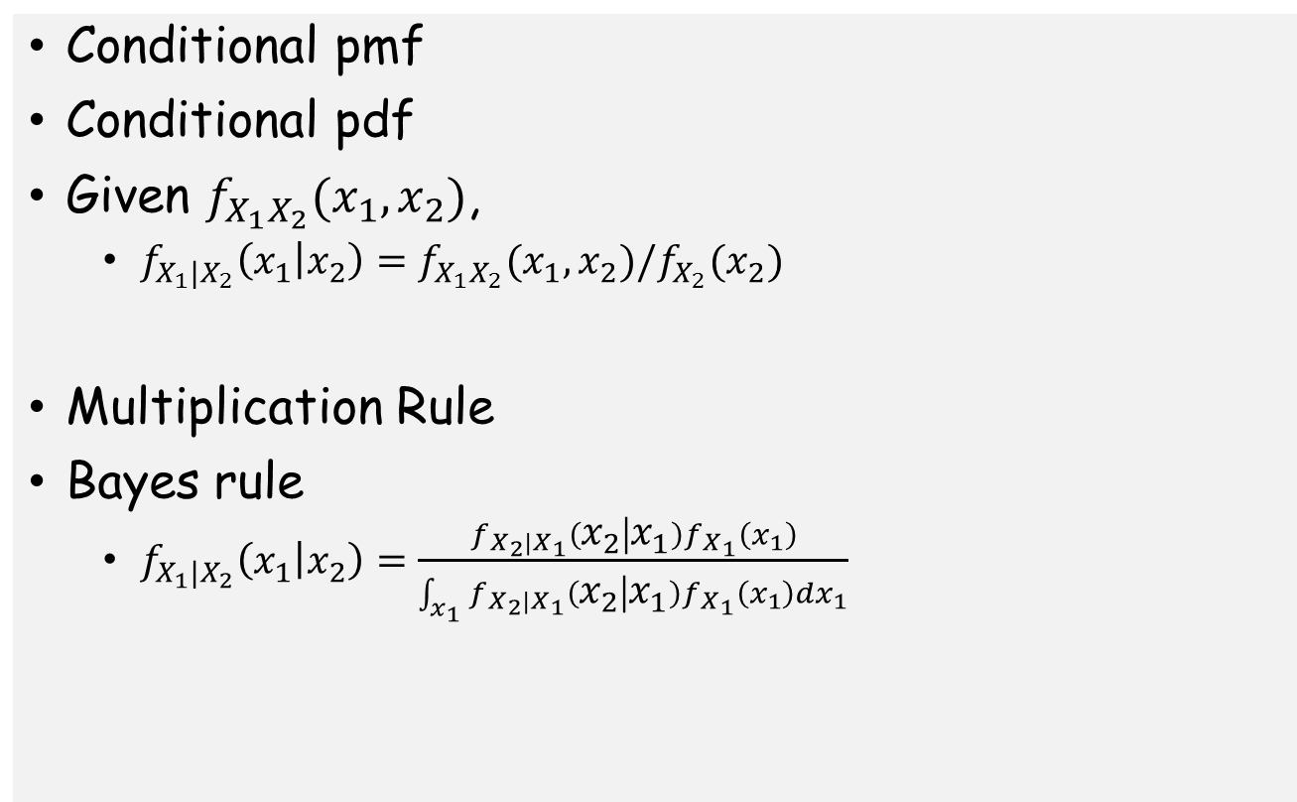
Conditional Probability
Conditional pmf
Conditional pdf
Given $f_{X_{1}X_{2}}(x_{1},x_{2})$,
$f_{X_{1}|X_{2}}\left(x_{1} | x_{2}\right)=f_{X_{1}X_{2}}(x_{1},x_{2})/f_{X_{2}}(x_{2})$
Multiplication Rule
Bayes rule
$f_{X_{1}|X_{2}}\left(x_{1} | x_{2}\right)=\frac{f_{X_{2}|X_{1}}\left(x_{2} | x_{1}\right)f_{X_{1}}\left(x_{1}\right)}{\int_{x_{1}}{f_{X_{2}|X_{1}}\left(x_{2} | x_{1}\right)f_{X_{1}}\left(x_{1}\right)dx_{1}}}$

Slide 15
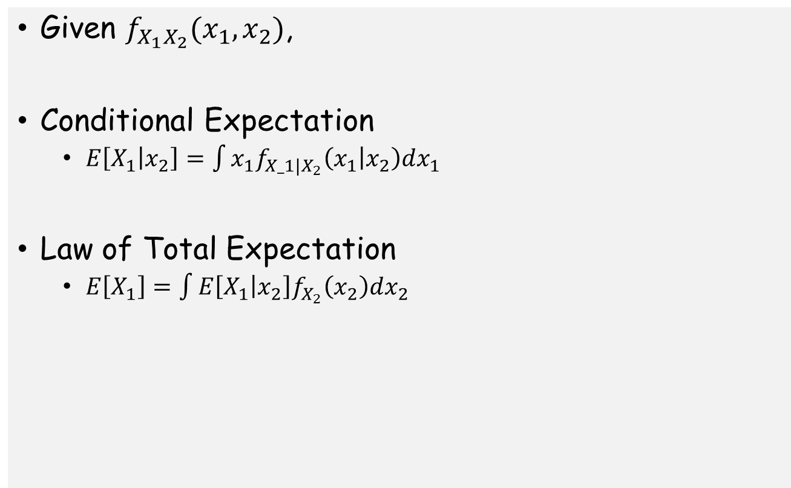
Conditional Probability
Given $f_{X_{1}X_{2}}(x_{1},x_{2})$,
Conditional Expectation
$E\left[X_{1} | x_{2}\right]=\int{x_{1}f_{X_1|X_{2}}\left(x_{1} | x_{2}\right)dx_{1}}$
Law of Total Expectation
$E\left[X_{1}\right]=\int{E\left[X_{1} | x_{2}\right]f_{X_{2}}\left(x_{2}\right)dx_{2}}$

